Slide 1
Introduction to Web Programming

Slide 2
How this Course is Structured
This course is about both learning programming skills and using them to benefit our community.
We will learn to program in various programming languages, but we will also discuss how these skills can benefit our friends, family and the community that we belong to.

Slide 3
Three Simple Components To Any Web Development
Backend Server
This server is responsible for retrieving and distributing data from database.
PHP, Ruby, Java are some of the popular choices.
We will use Node.js for our backend server.
Frontend Server
Also known as thin client vs thick client
User facing
Can request data from backend server and display to users in a user friendly way.
We will use Angular for our frontend server
Database
Data is stored
Two types: relational database like SQL or NoSQL like MongoDB and Cache.
We will use Node.js MySQL.

Slide 4
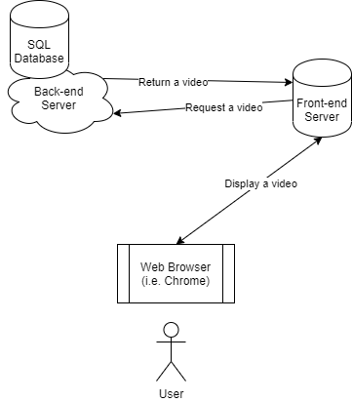
Three Simple Components To Any Web Development

Slide 5
The Plan
We will use node.js express server as our backend server. This is one of the easiest way to implement a server. We will use RESTful approach in developing our backend server.
We will use Angular Framework in developing a client server. This is the most popular framework in the industry and I think it’s going to be a good exercise.
We will host our servers in AWS EC2 machine. AWS EC2 offers free 12 months as a signup bonus. Besides, we can’t run our Angular and node.js servers on shared hosting services like Bluehost and Hostmonster. We would have to purchase private dedicated servers, which are pretty expensive.

Slide 6
Why Use Framework?
You might wonder why use framework, when you know all your Javascript and HTML.
Using a good framework like Angular forces you to be a good programmer by following important paradigms like object-oriented approaches, encapsulation and hierarchies.
It organizes your code in discrete ways that are helpful for other developers to understand and enhance your program.
If you use pure Javascript and HTML to develop a web server, it will probably devolve into code spaghetti that only you can understand. And, that is very bad.

Slide 7
Tools of Trade
You will need to
Download Node.js @ https://nodejs.org/en/
Download Angular
npm install –g @angular/cli
Download Github Desktop @ https://desktop.github.com/
Sign up for Github
Download Atom or any IDE (Integrated Development Editor) you are comfortable with @ https://atom.io/

Slide 8
Setting up AWS EC2 Machine

Slide 9
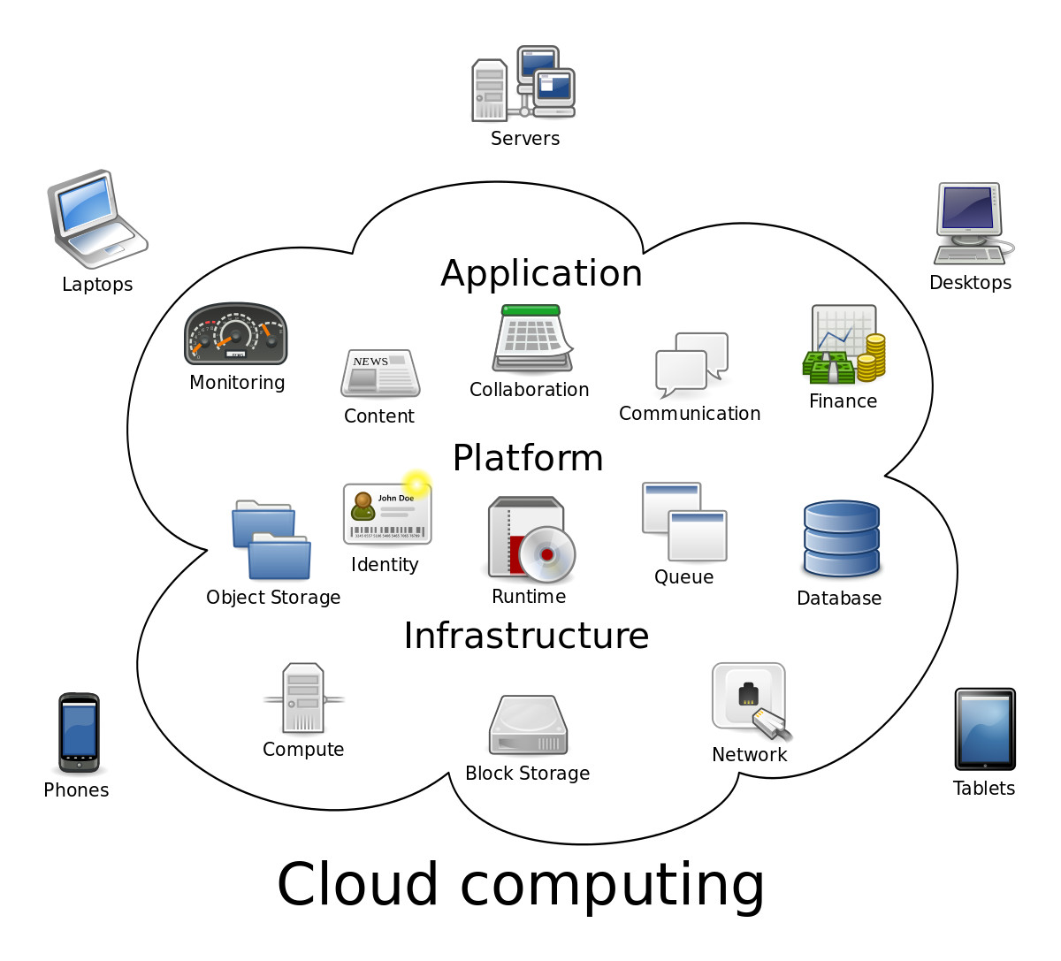

Slide 10
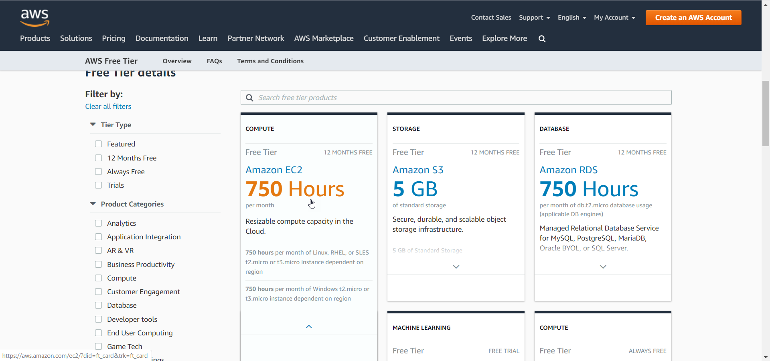
Amazon EC2
Amazon EC2 is free for the first 12 months for new customers
https://aws.amazon.com/free/?all-free-tier.sort-by=item.additionalFields.SortRank&all-free-tier.sort-order=asc

Slide 11
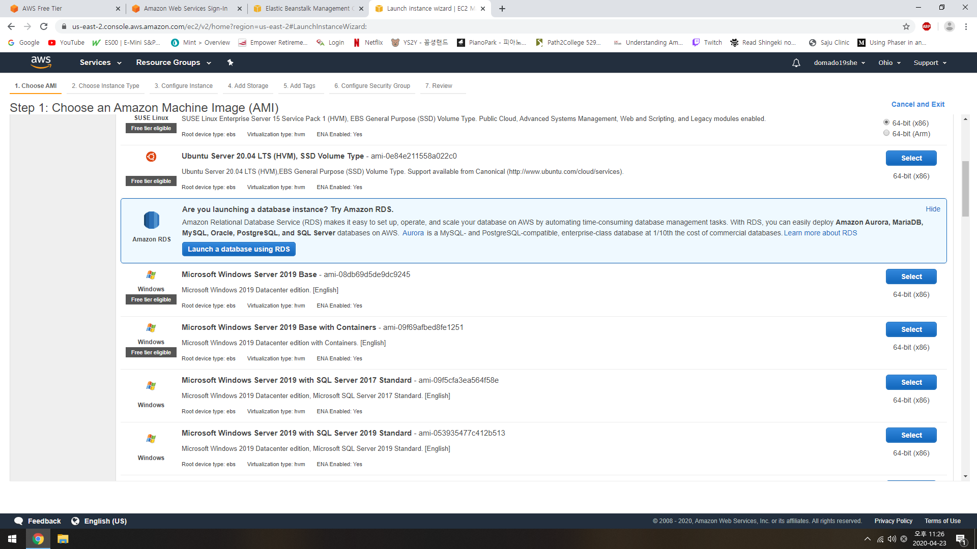
I’ll create a Windows instance since I’m most familiar with Windows. You can create a Linux environment if you want.

Slide 12
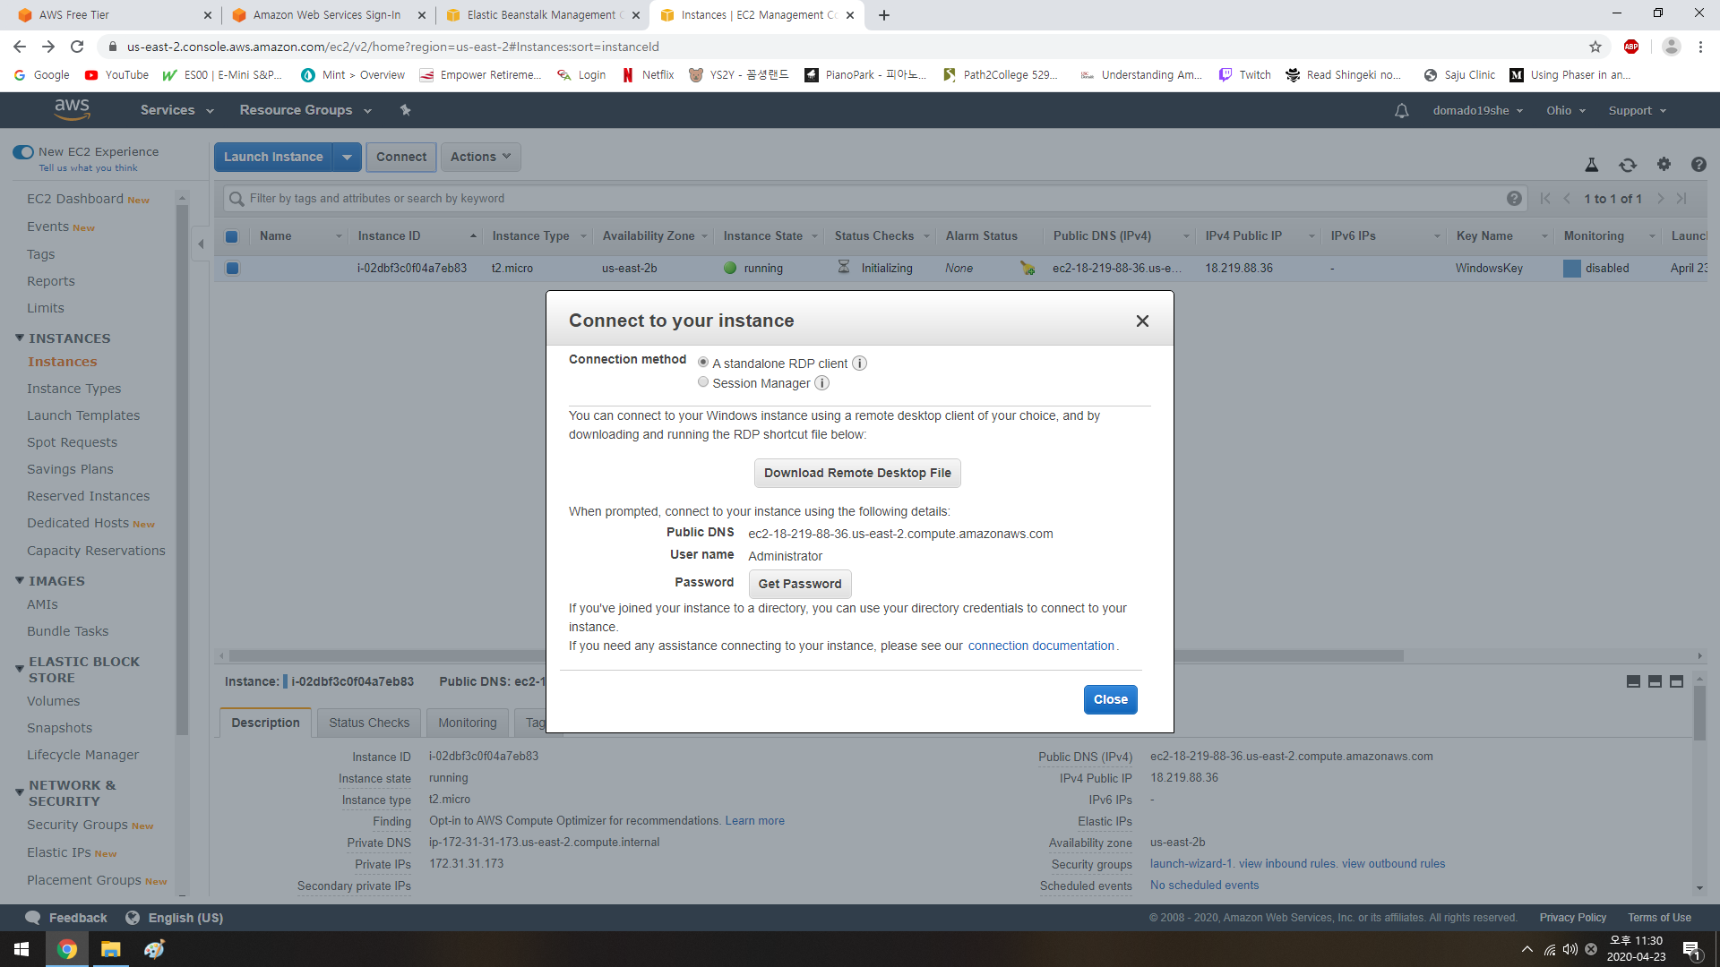
You will download a private key and log in using a Remote Desktop Application (for Windows).

Slide 13
Creating Our First Angluar Application
Technically my Angular Application, you guys will have to do yours

Slide 14
Creating Angular Application
Install Angular CLI
npm install –g @angular/cli
Add angular routing
Select CSS or SCSS
Open up a console and type
ng new [MyGames]
I’m thinking of creating a web app that I can share with my friends. It will have a list of games that I have played and my ratings on the games. It will also list games that I wish to play.
I will store the two lists in my SQL server. When I need to get the lists, I’ll invoke a REST API in my client server to my backend server, which will fetch the lists. My client server can also add/modify/delete items in the lists.

Slide 15
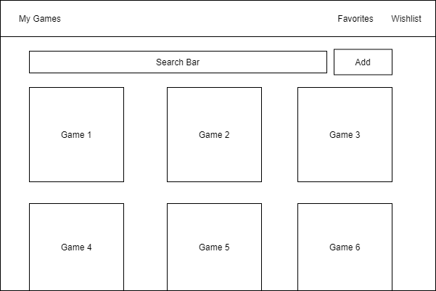
Creating Angular Application Rough Design using draw.io [Export as PNG]

Slide 16
Creating Angular Application
To style our web application, we’ll use Angular Material. There is a ton of materials on Angular Material on Web. You can google anything and it’s literally there.
We’ll download Material by
npm install @angular/material --save
npm install @angular/cdk –save
To open your project, go to Atom
File->Open Folder

Slide 17
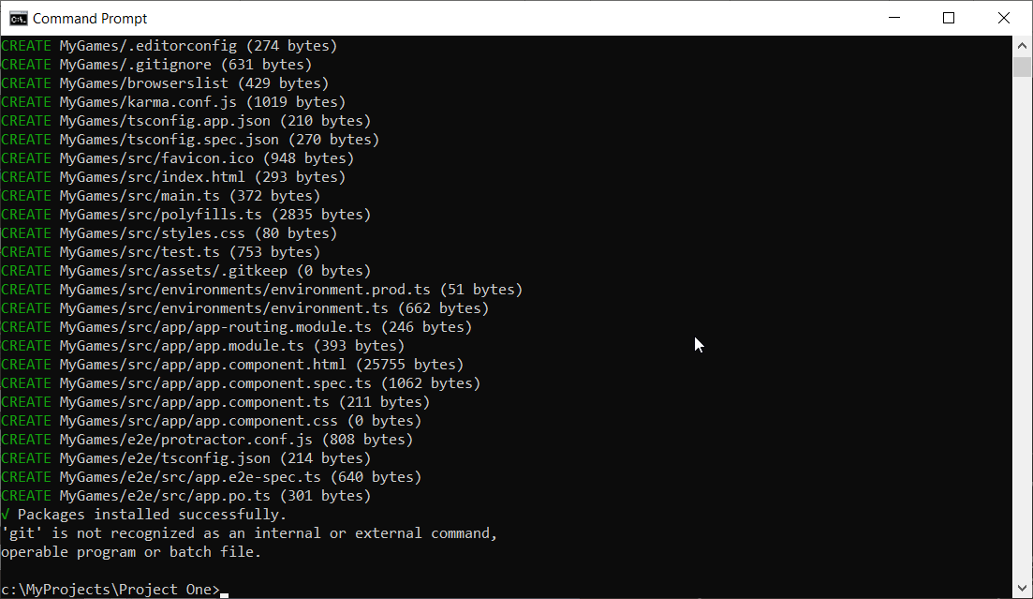
Creating Angular Application

Slide 18
Creating Angular Application
Commands I ran
ng new MyGames
ng generate component favorites
ng generate component wishlist
npm install @angular/material --save
npm install @angular/cdk --save
ng generate class Game

Slide 19
All Hands On Deck
Task | Due | By | LOE
Discuss general direction | Today | All | 2
Rough Design of Personal Web App | Next week | All | 3
Set up Github accounts | Next week | All | 1
Create your own web app | Next week | All | 1

